Slide 1
Affordability Measurement Project Winter Workshop 2012
PSM

Slide 2
Some Working Definitions
Affordability is the balance of system performance, cost and schedule constraints over the system life while satisfying mission needs in concert with strategic investment and organizational needs. (INCOSE Affordability Working Group)
Design for Affordability is the Systems Engineering practice of balancing system performance and risk with cost and schedule constraints over the system life satisfying system operational needs in concert with strategic investment and evolving stakeholder value. (INCOSE Affordability Working Group)
Affordability is the practice of ensuring program success through the balancing of system performance (KPPs), total ownership cost , and schedule constraints while satisfying mission needs in concert with long-range investment, and force structure plans of the DoD (NDIA Affordability Working Group)
Affordability Measurement is the use of quantitative methods to provide insight into the effectiveness of affordability practices and/or techniques used to perform affordability analyses.

Slide 3
Industry Affordability Teams
INCOSE Affordability Working Group – Joe Bobinis, Lockheed Martin, Chair
NDIA Affordability Working Group – Frank Serna, Draper Laboratory, Chair

Slide 4
INCOSE Affordability Working Group
Affordability: Cost Effectiveness Capability over Time White Paper
Impact to affordability by managing a system as a trade space as opposed to a point solution
Factors to consider when developing a trade space that support a system throughout its life cycle
Epoch/Era Analysis

Slide 5
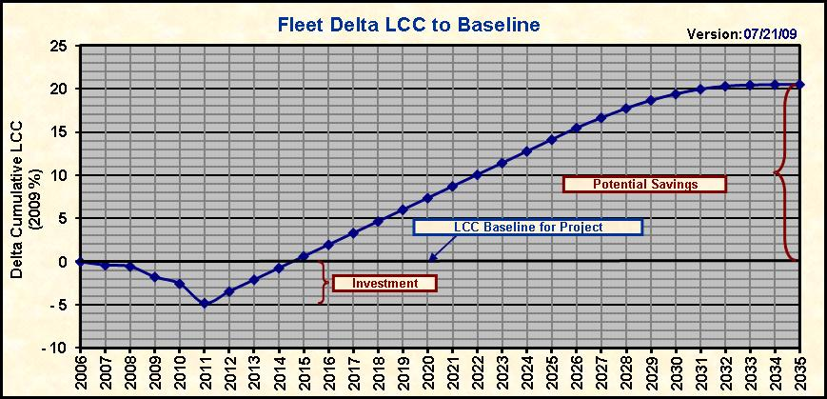
INCOSE: Cost Effective Capability Over Time
This chart indicates an investment during the 2009-11 timeframe. Costs are plotted comparing an investment opportunity, such as a modification, vs. the projected project baseline. Costs below the baseline indicate costs greater than the baseline – investment. Cost break-even occurs just prior to 2015 and cost savings increase thereafter. Costs are cumulative and the final cost at the end of the Life Cycle indicates the potential Delta Life Cycle Cost (DLCC) for the modification or improvement being analyzed – total Life-Cycle Savings

Slide 6
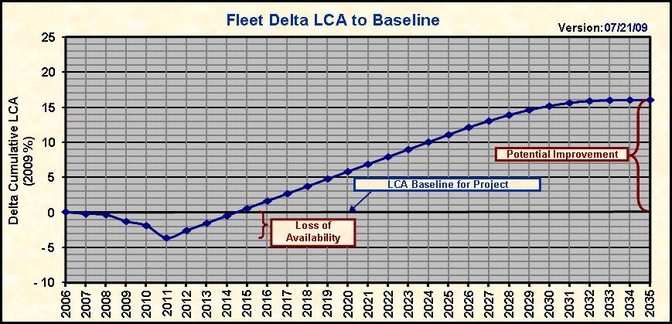
INCOSE: Cost Effective Capability Over Time
In a similar manner, other KPPs can be calculated showing a return for an investment in time or materials. The Life-Cycle Availability for a given system yields a similar graph where time (Availability) is lost during the improvement activity – an investment in Availability is made and a return with a break-even point is established, just as with cost. This KPP also yields a delta at the end of the Life-Cycle – in this case a Delta Life-Cycle Availability (DLCA).

Slide 7
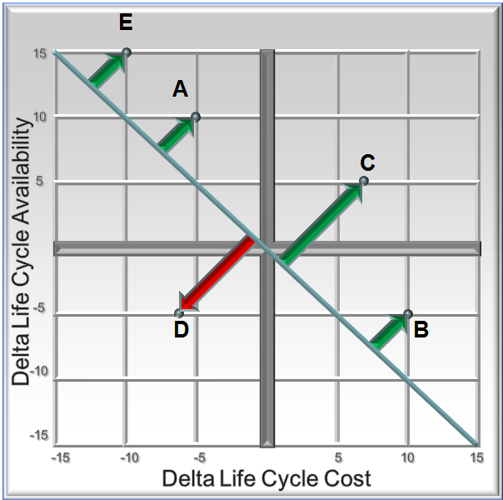
INCOSE: Cost Effective Capability Over Time
In this figure, the normalized values of Availability and Cost are plotted. This represents five potential improvement projects. The best potential project is the point lying furthest from the diagonal, not the project with the highest Availability return or highest Cost savings. The angle of the diagonal represents the relative weights given to the KPPs. If KPPs are weighted equally, the diagonal lies at 45° to the axis.

Slide 8
NDIA Affordability WG Status

Slide 9
Major Concern: Ashton Carter Memos
Pre Milestone A (Materiel Solution Analysis)
Average unit acquisition cost
Average annual operating and support cost per unit
Analysis that shows results of capability excursions around expected design performance design points
During Technology Development (TD), Engineering and Manufacturing Development (EMD) and even Sustainment
continuous should-cost analysis
Trade off analysis showing how cost varies as major design parameters and schedule are traded off against each other
Acquisition Decision Memorandum (ADM) Affordability requirement; cost tradeoff curves or trade space around major affordability drivers

Slide 10
Affordability Evaluation Measure
Set of characteristics associated with an affordable system
Criteria for various levels of each characteristic
Weighting factors for each characteristic
Calculate overall value for program
Do jointly (acquirer/ supplier) periodically
key managers consensus
Trend over time
“What are the questions we need answers for” should drive characteristics

Slide 11
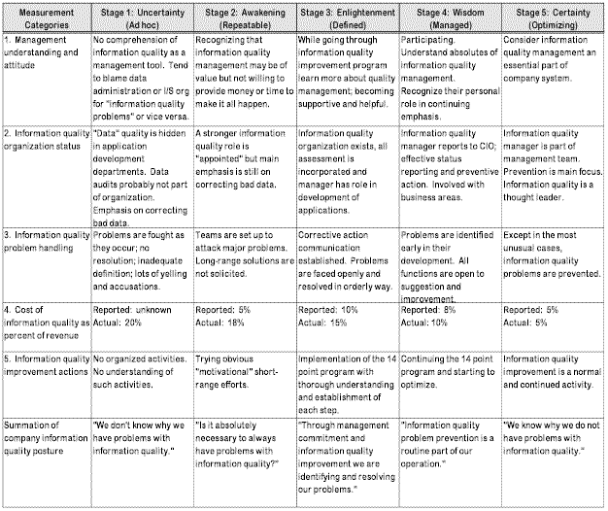
Crosby Quality Management Maturity Grid

Slide 12
-ilities
Maintainability
Supportability
Reliability
Stability
Produceability
Upgradeability
Usability

Slide 13
Other Issues
Acquisition viewpoint vs. Supplier viewpoint
Enterprise vs. Program view
Need for a literature review
Is the approach different for IT than product development?
Impact of Should Cost Analysis
Need to be better at estimation to be better at affordability analysis
Benchmarking, historical data sharing
Interoperating and enabling system influence
“flexible” and/or volatile requirements
Interests of the commercial world

Slide 14
Affordability Is a Team Sport
A11-34172D_14
Notes:
Competitive Intelligence
Affordability is in the Eye of the Customer, Sets Price to Win
Critical to Should Cost Reviews
How Often is CI Used Throughout Program Lifecycle?
Business Capture
Traded Requirements, Total Cost of Ownership
Branding / Image ➔Why is LM the “Affordable” Option
Offer Value-Rich Idea Space
Program Management
Demonstrates Value and Performance
Customer Perspective
Red / Green Programs

Slide 15
Next Steps

Slide 16
Notes:
Now, I’m anxious to hear what’s on your minds, so let’s open it up for questions and discussion … and don’t hesitate to let me know what I can do to help you effect the change we know we need to make.

Slide 17
Affordability: Cost Effective Capability Over Time

Slide 19
Practical Software and Systems Measurement (PSM)
PSM is a proven approach for defining and implementing an effective measurement process for software and system projects that provide project and technical managers the quantitative information required to make informed decisions that impact project cost, schedule and technical performance objectives.
PSM underlies several INCOSE measurement publications
Basis for ISO 15939, Systems and Software Measurement Process
In recent years has concentrated on “special topics” in measurement, hence an initiative in the Affordability space

Slide 20
The Project So Far
Have used workshops at the PSM Users Group Conference to gather issues, ideas etc
Ready to move forward with a focused effort
Desire to coordinate with interested parties
Expected Result
White Paper providing measurement amplification to INCOSE and NDIA affordability work along with addressing other relevant affordability issues in measurement

